Slide 1
FILE ORGANIZATION & INDEXES
IE2042- Database Management Systems for Security- Lecture6

Slide 2

Learning Outcomes (LO3)
Understand the importance of file organization
Identify the types of organizing files
Understand the uses of indexes
Identify ways to create indexes
Understand access methods

Slide 3
FILE ORGANIZATION

Slide 4
Files of Records
Page or block is OK when doing I/O, but higher levels of DBMS operate on records, and files of records.
FILE: A collection of pages, each containing a collection of records. Must support:
insert/delete/modify record
read a particular record (specified using record id)
scan all records (possibly with some conditions on the records to be retrieved)
Notes:
13

Slide 5
File Organization
There are three types
Heap File Organization
Sequential File Organization
Hashing File Organization

Slide 6
Alternative File Organizations
Many alternatives exist, each ideal for some situation, and not so good in others
Heap Files- Suitable when typical access is a file scan retrieving all records.
Search (Equality/Range)- needs to scan the file
Insert- at the end of file
Delete- search for record and delete record
Sequential Files- Best if records must be retrieved in some order, or only a `range’ of records is needed.
Search (Equality/Range)- efficient
Insert- finding the position, inserting and move records
Delete- search for record, delete and move records
Notes:
2

Slide 7
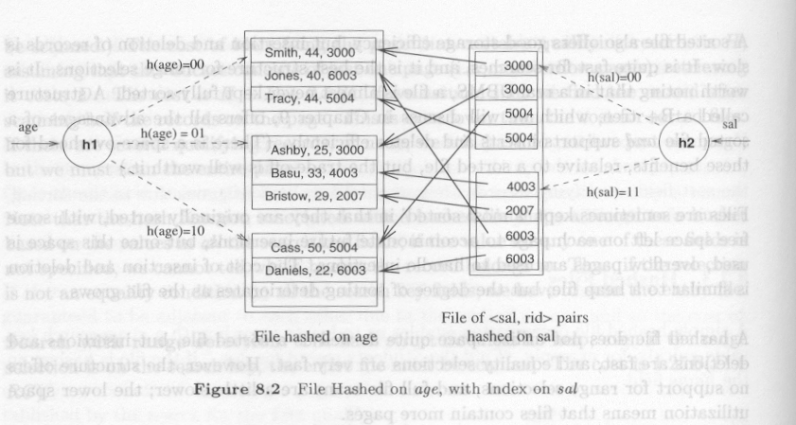
Alternative File Organizations (contd)
Hashed Files- Good for equality selections
File is a collection of buckets.
Bucket = primary page plus zero or more overflow pages.
Hashing function h: h(r) = bucket in which record r belongs.
h looks at only some of the fields of r, called the search fields.
Search (Equality)- good for equality (if based on search key). Otherwise scan table
Search (Range)- needs to scan the file
Insert- search for primary bucket (hash) and insert
Delete- search for primary bucket (hash) if available, else scan file and delete record

Slide 8
INDEXES

Slide 9
Indexes
An index on a file speeds up selections on the search key fields for the index.
Any subset of the fields of a relation can be the search key for an index on the relation
Search key is not the same as key (minimal set of fields that uniquely identify a record in a relation)
Index provides fast access
Index takes space
Need to be careful in creating only useful indexes
May slow down certain inserts/updates/ deletes (maintain indexes)
Notes:
7

Slide 10
Alternatives for Data Entry k* in Index
An index contains a collection of data entries, and supports efficient retrieval of all data entries k* with a given key value k.
File of records containing index entries = Index File
Three alternatives: (Methods to connect index data to file records)
1. Data record with key value k (Alt. 1)
2. <k, RID of data record with search key value k> (Alt. 2)
3. <k, list of RIDs of data records with search key k> (Alt. 3)
There are several organization techniques for building index files = Access Methods
Notes:
8

Slide 11
Properties of Indexes
Clustered vs. Un-Clustered Index
Can have at most one clustered index per table
Cost of retrieving data records through index varies greatly based on whether index is clustered or not!
Index entries
UNCLUSTERED
CLUSTERED
direct search for
data entries
Data entries
Data entries
(Index File)
(Data file)
Data Records
Data Records
Notes:
12

Slide 12
Properties of Indexes [contd]
Sparse vs. Dense Index
If there is at least one data entry per search key value (in some data record), then dense.
Alt. 1 always leads to dense index.
Every sparse index is clustered!
Sparse indexes are smaller; however, some useful optimizations are based on dense indexes.
Ashby, 25, 3000
Basu, 33, 4003
22
Bristow, 30, 2007
25
Ashby
30
Cass
Cass, 50, 5004
33
Smith
Daniels, 22, 6003
Jones, 40, 6003
40
44
Smith, 44, 3000
44
Tracy, 44, 5004
50
Sparse Index
Dense Index
on
Data File
on
Name
Age
Notes:
13

Slide 13
Properties of Indexes [contd]
Examples of composite key
indexes using lexicographic order.
Primary vs. Secondary Index
Primary Index- Search key contains primary key
Unique index- Search key contains a candidate key
Composite Index- Search on a combination of fields.
Equality query: Every field value is equal to a constant value
age=20 and sal =75
Range query: Some field value is not a constant
age =20; or age=20 and sal > 10
Data entries in index sorted by search key to support range queries
11,80
11
12,10
12
12,20
name
age
sal
12
13,75
bob
12
10
13
<age, sal>
cal
11
80
<age>
joe
12
20
10,12
sue
13
75
10
20,12
Data records
sorted by name
20
75,13
75
80,11
80
<sal, age>
<sal>
Data entries in index
sorted by <sal,age>
Data entries
sorted by <sal>
Notes:
13

Slide 14
Indexes in SQL
Index is not a part of SQL-92
However, all major DBMSs provide facilities for index creation
CREATE INDEX…
DROP INDEX….
SQL Server support indexes (clustered and non-clustered indexes)

Slide 15
Range Searches
``Find all students with gpa > 3.0’’
If data is in sorted file, do binary search to find first such student, then scan to find others.
Cost of binary search can be quite high.
Simple idea: Create an `index’ file.
k1
k2
kN
Index File
Page 1
Page 2
Page 3
Page N
Data File
Can do binary search on (smaller) index file!
Notes:
3

Slide 16
B+ Tree: The Most Widely Used Index
Insert/delete at log _{F} N cost; keep tree height-balanced. (F = fanout, N = # leaf pages)
Minimum 50% occupancy (except for root). Each node (except root) contains d <= m <= 2d entries. The parameter d is called the order of the tree.
Supports equality and range-searches efficiently.
Index Entries
(Direct search)
Data Entries
("Sequence set")
Notes:
9

Slide 17
B+ Trees in Practice
Typical order: 100. Typical fill-factor: 67%.
average fanout = 133
Typical capacities:
Height 4: 133⁴ = 312,900,700 records
Height 3: 133³ = 2,352,637 records
Can often hold top levels in buffer pool:
Level 1 = 1 page = 8 Kbytes
Level 2 = 133 pages = 1 Mbyte
Level 3 = 17,689 pages = 133 MBytes

Slide 18
B+ Tree…
Search begins at root, and key comparisons direct it to a leaf
Each Node has search keys (K_{i}) and pointers (P_{i}).
P_{i} points to a sub-tree in which all key values K are such that K_{i} ≤ K < K_{i+1}
Notes:
10

Slide 19
Search
func tree_search (nodepointer, search key value K) returns nodepointer
/ / Searches tree for entry
if *nodepointer is a leaf, return nodepointer;
else,
if K < K1 then return tree_search(Po, K);
else,
if K ≥ Km then return tree_search(Pm, K) // m = # entries
else,
find i such that Ki ≤K < Ki+1;
return tree_search(Pi, K)
end if
end if

Slide 20
Example B+ Tree…
Search for 5*, 15*, all data entries >= 24* ...
Root
13
17
24
30
2*
3*
5*
7*
14*
16*
19*
20*
22*
24*
27*
29*
33*
34*
38*
39*
Based on the search for 15*, we know it is not in the tree!

Slide 21
Inserting a Data Entry into a B+ Tree
Find correct leaf L.
Put data entry onto L.
If L has enough space, done!
Else, must split L (into L and a new node L2)
Redistribute entries evenly, copy up middle key.
Insert index entry pointing to L2 into parent of L.
This can happen recursively
To split index node, redistribute entries evenly, but push up middle key. (Contrast with leaf splits.)
Splits “grow” tree; root split increases height.
Tree growth: gets wider or one level taller at top.
Notes:
6

Slide 22
Inserting 8* into Example B+ Tree
Observe how minimum occupancy is guaranteed in both leaf and index pg splits.
Note difference between copy-up and push-up; be sure you understand the reasons for this.
Entry to be inserted in parent node.
5
(Note that 5 is
s copied up and
continues to appear in the leaf.)
2*
3*
5*
7*
8*
Entry to be inserted in parent node.
17
(Note that 17 is pushed up and only
appears once in the index. Contrast
this with a leaf split.)
5
13
24
30
Notes:
12

Slide 23
Example B+ Tree After Inserting 8*
Root
17
5
13
24
30
2*
3*
5*
7*
8*
14*
16*
19*
20*
22*
24*
27*
29*
33*
34*
38*
39*
Notice that root was split, leading to increase in height.
In this example, we can avoid split by re-distributing entries; however, this is usually not done in practice.
Notes:
13

Slide 24
Deleting a Data Entry from a B+ Tree
Start at root, find leaf L where entry belongs.
Remove the entry.
If L is at least half-full, done!
If L has only d-1 entries,
Try to re-distribute, borrowing from sibling (adjacent node with same parent as L).
If re-distribution fails, merge L and sibling.
If merge occurred, must delete entry (pointing to L or sibling) from parent of L.
Merge could propagate to root, decreasing height.
Notes:
14

Slide 25
Example Tree After (Inserting 8*, Then) Deleting 19* and 20* ...
Root
17
5
13
27
30
2*
3*
5*
7*
8*
14*
16*
22*
24*
27*
29*
33*
34*
38*
39*
Deleting 19* is easy.
Deleting 20* is done with re-distribution. Notice how middle key is copied up.
Notes:
15

Slide 26
... And Then Deleting 24*
Must merge.
Observe `toss’ of index entry (on right), and `pull down’ of index entry (below).
30
22*
27*
29*
33*
34*
38*
39*
Root
5
13
17
30
2*
3*
5*
7*
8*
14*
16*
22*
27*
29*
33*
34*
38*
39*
Notes:
16

Slide 27
Duplicates in B+ Trees…
We have ignored duplicates so far…
Alternatives…
Overflow leaf pages
Duplicate values in the leaf pages
Make unique key values (by adding rowid’s)
Preferred approach by many DBMSs

Slide 28

The End…
Complete the tutorial

